Slide 1

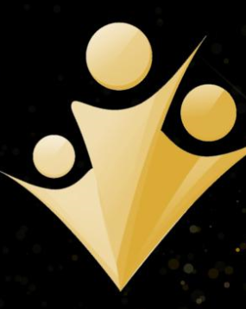
RAP Student Entitlement
Education March 2017

Slide 2
Student-Staff Partnership
How students come to co-own their programmes with lecturers and see themselves as active contributors to the assessment feedback process rather than seeing assessment as something that is done to them.

Slide 3
Holistic Assessment Framework
EAT: 3 main areas:
Assessment Literacy
Assessment Feedback
Assessment Design

Slide 4
Our priorities 2016-17
Clarifying what constitutes good
Student Entitlement
Focused Feedback

Slide 5
Aim
Can we agree a baseline of student entitlement in Education?
Can programmes agree a baseline of student entitlement?

Slide 6
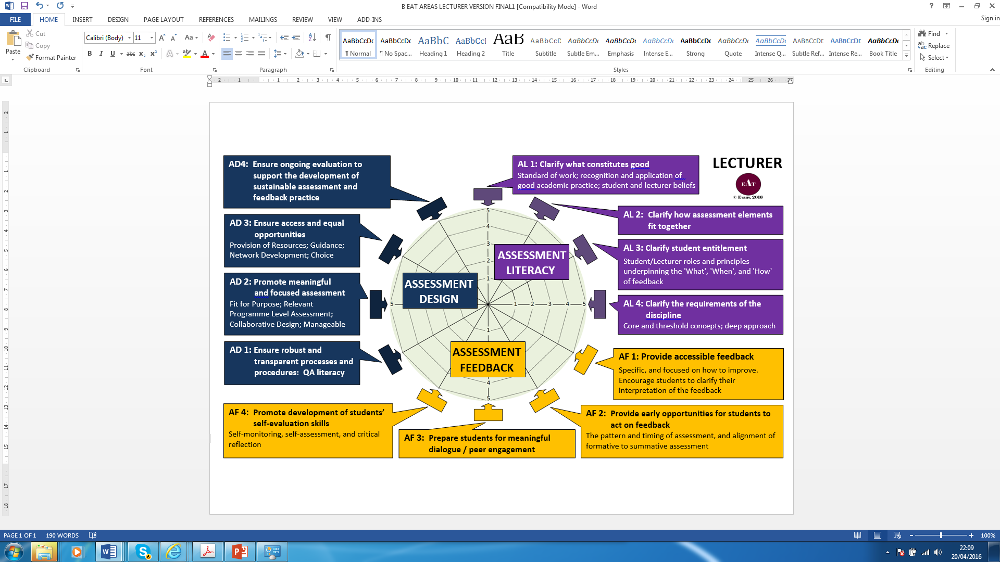

Slide 7
Student Entitlement
Does our curriculum design allow students to engage with all dimensions of assessment and feedback?

Slide 8
Student Entitlement
How are we helping students to help themselves and in doing so help us?

Slide 9
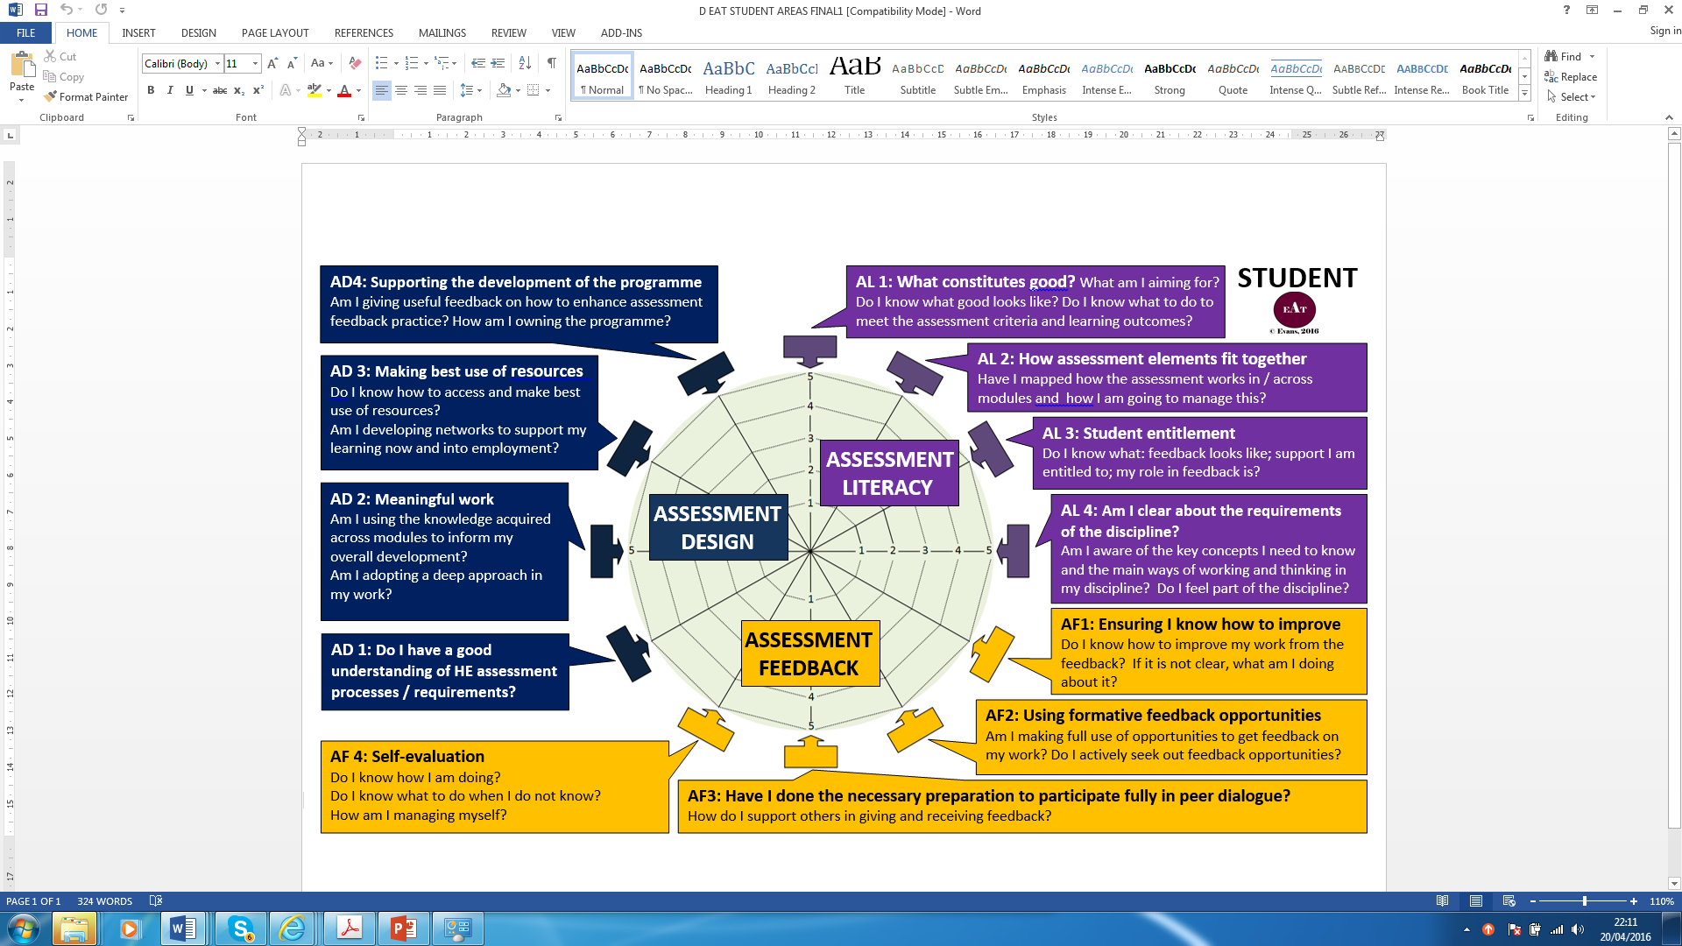

Slide 10
Student Entitlement
Key concepts: Partnership; Boundaries; Self-regulation; Professional, Statutory and Regulatory Body requirements.

Slide 11
Entry steps
What is a deep approach within your discipline? What does good look like?
What are your expectations regarding student engagement – what is negotiable and what is not.
What is it to be a member of your community?
Clarify what student-staff partnership looks like within your discipline.

Slide 12
In Practice
Clarity about:
what is available
what does it look like
how to access it
what is the staff and student role in all of it
how to get support from relevant teams
student role in helping themselves

